Slide 1
앱 프로그래밍(1) 과제
Android Studio Report 3주차
소프트웨어융합과_코딩전공
2301111_김진용

Slide 2
Report 1
Activity_report1.xml
<?xml version="1.0" encoding="utf-8"?> <LinearLayout xmlns:android="http://schemas.android.com/apk/res/android" xmlns:tools="http://schemas.android.com/tools" android:id="@+id/main" android:layout_width="match_parent" android:layout_height="match_parent" android:orientation="vertical" tools:context=".Report1"> <LinearLayout android:layout_width="match_parent" android:layout_height="wrap_content" android:layout_margin="10dp" android:orientation="vertical"> <Button android:id="@+id/naver" android:layout_width="match_parent" android:layout_height="wrap_content" android:onClick="buttonClicked" android:text="NAVER 홈페이지 열기" android:textSize="20dp" /> <Button android:id="@+id/call"

Slide 3
android:layout_width="match_parent“
android:layout_height="wrap_content" android:backgroundTint="@color/green" android:onClick="buttonClicked" android:text="119 응급전화 걸기" android:textSize="20dp" /> <Button android:id="@+id/dial" android:layout_width="match_parent" android:layout_height="wrap_content" android:backgroundTint="@color/green" android:text="119 응급전화 Dial" android:textAllCaps="false" android:textSize="20dp" /> <Button android:id="@+id/gallery" android:layout_width="match_parent" android:layout_height="wrap_content" android:backgroundTint="@color/teal_200" android:text="Gallery 열기" android:textAllCaps="false" android:textSize="20dp" />

Slide 4
<Button android:id="@+id/exit" android:layout_width="match_parent" android:layout_height="wrap_content" android:backgroundTint="@color/red" android:text="끝내기" android:textSize="20dp" /> </LinearLayout> </LinearLayout>
Report1.java
package com.example.myapplication; import android.Manifest; import android.content.Intent; import android.content.pm.PackageManager; import android.net.Uri; import android.os.Bundle; import android.view.View; import android.widget.Button; import android.widget.Toast; import androidx.appcompat.app.AppCompatActivity; import androidx.core.app.ActivityCompat; import androidx.core.content.ContextCompat; }

Slide 5
public class Report1 extends AppCompatActivity{ @Override protected void onCreate(Bundle savedInstanceState) { super.onCreate(savedInstanceState); setContentView(R.layout.activity_report1); Button naver = findViewById(R.id.naver); Button dial = findViewById(R.id.dial); Button gallery = findViewById(R.id.gallery); Button exit = findViewById(R.id.exit); naver.setOnClickListener(new View.OnClickListener() { @Override public void onClick(View view) { Intent intent = new Intent(Intent.ACTION_VIEW, Uri.parse("http://m.naver.com")); startActivity(intent); } }); Report1_OnClickListener onClickListener = new Report1_OnClickListener(dial, gallery); dial.setOnClickListener(onClickListener); View.OnClickListener onClickListener1 = new View.OnClickListener() {
@Override public void onClick(View view) {
Intent intent = new Intent(Intent.ACTION_VIEW, Uri.parse("content://media/internal/images/media"));

Slide 6
view.getContext().startActivity(intent); } }; gallery.setOnClickListener(onClickListener1); exit.setOnClickListener(new View.OnClickListener() { @Override public void onClick(View view) { finish(); Toast.makeText(getBaseContext(),"끝냅니다",Toast.LENGTH_SHORT).show(); } }); } /**[ On Click 속성 ] * 응급전화 걸기 < 교수님께 질문 필수 권한부여를 꼭 해야 하는가 ************************/ private static final int REQUEST_CALL_PERMISSION = 1; public void buttonClicked(View view) { if (ContextCompat.checkSelfPermission(Report1.this, android.Manifest.permission.CALL_PHONE) != PackageManager.PERMISSION_GRANTED) { ActivityCompat.requestPermissions(Report1.this, new String[]{Manifest.permission.CALL_PHONE}, REQUEST_CALL_PERMISSION); } else { Intent intent = new Intent(Intent.ACTION_CALL, Uri.parse("tel:119")); startActivity(intent); } }

Slide 7
Report1_OnClickListener.java
package com.example.myapplication; import android.content.Intent; import android.net.Uri; import android.view.View; import android.widget.Button; public class Report1_OnClickListener implements View.OnClickListener { Button dial; Button gallery; public Report1_OnClickListener(Button dial, Button gallery) { this.dial = dial; this.gallery = gallery; } @Override public void onClick(View view) { Intent intent = new Intent(Intent.ACTION_DIAL, Uri.parse("tel:119")); view.getContext().startActivity(intent); } }

Slide 8
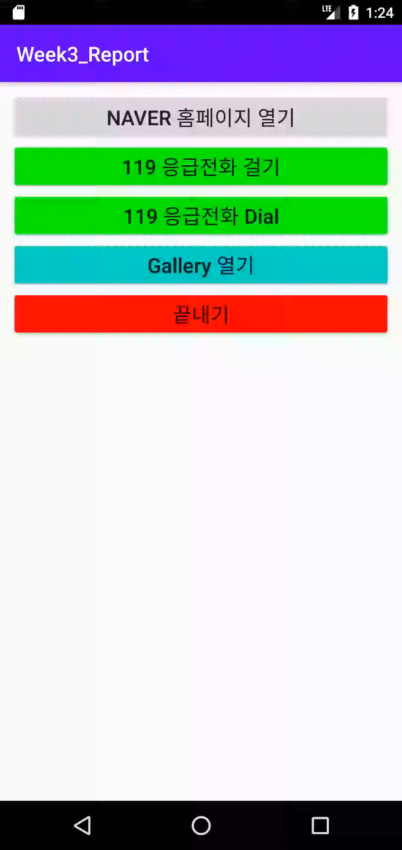
Report 1
실행화면

Slide 9
Report 2
Activity_report2.xml
<?xml version="1.0" encoding="utf-8"?> <LinearLayout xmlns:android="http://schemas.android.com/apk/res/android" xmlns:tools="http://schemas.android.com/tools" android:id="@+id/main" android:layout_width="match_parent" android:layout_height="match_parent" android:orientation="vertical" tools:context=".Report2"> <LinearLayout android:layout_width="match_parent" android:layout_height="wrap_content" android:layout_margin="5dp" android:orientation="vertical"> <TextView android:layout_width="match_parent" android:layout_height="wrap_content" android:text="정수를 입력해 주세요" android:textColor="@color/red" android:textSize="18dp" /> <LinearLayout android:layout_width="match_parent" android:layout_height="wrap_content" android:orientation="horizontal">

Slide 10
<EditText android:id="@+id/input1" android:layout_width="0dp" android:layout_height="wrap_content" android:layout_weight="1" android:gravity="center" android:hint="숫자1“
android:inputType="numberDecimal“ /> <EditText android:id="@+id/input2" android:layout_width="0dp" android:layout_height="wrap_content" android:layout_weight="1" android:gravity="center" android:hint="숫자2“
android:inputType="numberDecimal“ /> </LinearLayout> <Button android:id="@+id/plus" android:layout_width="match_parent" android:layout_height="wrap_content" android:text="더하기" android:textSize="18dp" />
<Button

Slide 11
android:id="@+id/minus" android:layout_width="match_parent"
android:layout_height="wrap_content"
android:text="빼기" android:textSize="18dp" /> <Button android:id="@+id/multiply" android:layout_width="match_parent" android:layout_height="wrap_content" android:text="곱하기" android:textSize="18dp" /> <Button android:id="@+id/division" android:layout_width="match_parent" android:layout_height="wrap_content" android:text="나누기" android:textSize="18dp" /> <Button android:id="@+id/remainder" android:layout_width="match_parent" android:layout_height="wrap_content" android:text="나머지" android:textSize="18dp" />

Slide 12
<TextView android:id="@+id/result" android:layout_width="match_parent" android:layout_height="wrap_content" android:text="결과 :" android:textSize="18dp"/> </LinearLayout> </LinearLayout>
Report2.java
package com.example.myapplication; import android.os.Bundle; import android.view.View; import android.widget.Button; import android.widget.EditText; import android.widget.TextView; import android.widget.Toast; import androidx.activity.EdgeToEdge; import androidx.appcompat.app.AppCompatActivity; import androidx.core.graphics.Insets; import androidx.core.view.ViewCompat; import androidx.core.view.WindowInsetsCompat; public class Report2 extends AppCompatActivity {

Slide 13
@Override protected void onCreate(Bundle savedInstanceState) { super.onCreate(savedInstanceState); setContentView(R.layout.activity_report2); EditText input1 = findViewById(R.id.input1); EditText input2 = findViewById(R.id.input2); Button plus = findViewById(R.id.plus); Button minus = findViewById(R.id.minus); Button multiply = findViewById(R.id.multiply); Button division = findViewById(R.id.division); Button remainder = findViewById(R.id.remainder); TextView result = findViewById(R.id.result); View.OnClickListener onClickListener = new View.OnClickListener() { @Override public void onClick(View view) { int check = view.getId(); String num1 = input1.getText().toString(); String num2 = input2.getText().toString(); if (num1.equals("") || num2.equals("")) { Toast.makeText(getBaseContext(),"입력해주세요",Toast.LENGTH_SHORT).show(); } else { int a = Integer.parseInt(num1);

Slide 14
int b = Integer.parseInt(num2); if (check == R.id.plus) { int plus_result = a + b; result.setText(String.format("%d + %d = %d", a, b, plus_result)); } else if (check == R.id.minus) { int minus_result = a - b; result.setText(String.format("%d - %d = %d", a, b, minus_result)); } else if (check == R.id.multiply) { int multiply_result = a * b; result.setText(String.format("%d * %d = %d", a, b, multiply_result)); } else if (check == R.id.division) { if (a == 0 || b == 0) { Toast.makeText(getBaseContext(),"0으로는 나눌 수 없습니다.",Toast.LENGTH_SHORT).show(); } else { float division_result = (float) a / b; result.setText(String.format("%d / %d = %.2f", a, b, division_result)); } } else if (check == R.id.remainder){ if (a == 0 || b == 0) { Toast.makeText(getBaseContext(),"0으로는 나눌 수 없습니다.",Toast.LENGTH_SHORT).show(); } else { int remainder_result = a % b; result.setText(String.format("%d %% %d = %d", a, b, remainder_result)); } }

Slide 15
} } }; plus.setOnClickListener(onClickListener); minus.setOnClickListener(onClickListener); multiply.setOnClickListener(onClickListener); division.setOnClickListener(onClickListener); remainder.setOnClickListener(onClickListener); } }

Slide 16
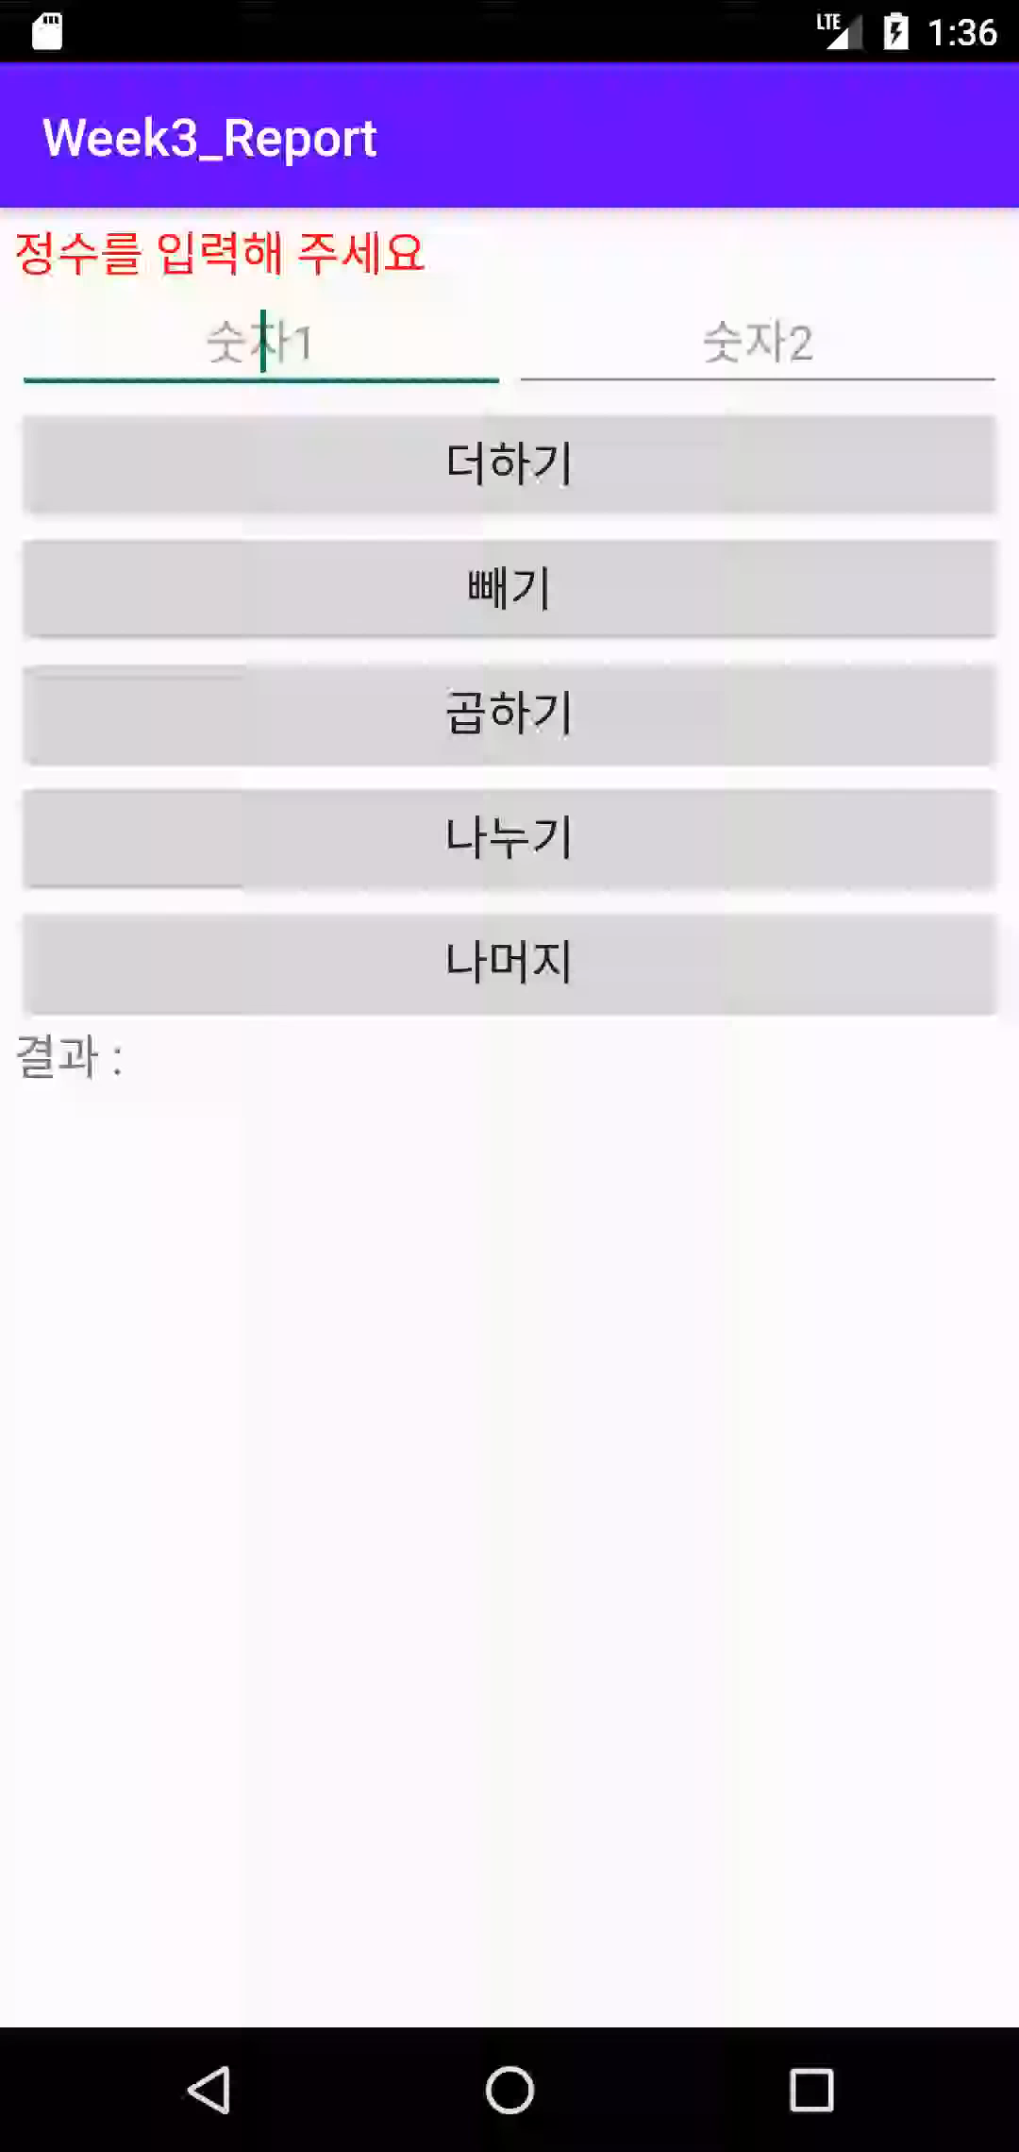
Report 2
실행화면

Slide 17
Report 3
Activity_report3.xml
<?xml version="1.0" encoding="utf-8"?> <LinearLayout xmlns:android="http://schemas.android.com/apk/res/android" xmlns:app="http://schemas.android.com/apk/res-auto" xmlns:tools="http://schemas.android.com/tools" android:id="@+id/main" android:layout_width="match_parent" android:layout_height="match_parent" android:orientation="vertical" tools:context=".Report3"> <LinearLayout android:layout_width="match_parent" android:layout_height="match_parent" android:orientation="vertical"> <LinearLayout android:layout_width="match_parent" android:layout_height="0dp" android:layout_weight="1" android:gravity="center" android:orientation="vertical"> <Switch android:id="@+id/switchButton"

Slide 18
android:layout_width="wrap_content" android:layout_height="wrap_content" android:layout_gravity="center" android:checked="true" android:text="Play with the Switch" /> <TextView android:id="@+id/switch_text" android:layout_width="wrap_content" android:layout_height="wrap_content" android:layout_marginTop="5dp" android:text="Switch is currently ON" android:textSize="18dp" /> </LinearLayout> <LinearLayout android:layout_width="match_parent" android:layout_height="0dp" android:layout_weight="1" android:background="@color/pupple_200" android:gravity="center" android:orientation="vertical"> <ToggleButton android:id="@+id/toggleButton" android:layout_width="wrap_content" android:layout_height="wrap_content" android:layout_gravity="center"

Slide 19
android:textOff="SWITCH ON THE TOGGLE BUTTON" android:textOn="SWITCH OFF THE TOGGLE BUTTON" /> <TextView android:id="@+id/toggle_text" android:layout_width="wrap_content" android:layout_height="wrap_content" android:layout_marginTop="5dp" android:text="Toggle Button OFF" android:textColor="@color/pupple_700" android:textSize="18dp" /> </LinearLayout> </LinearLayout> </LinearLayout>
Report3.java
package com.example.myapplication; import android.os.Bundle; import android.view.View; import android.widget.CompoundButton; import android.widget.Switch; import android.widget.TextView; import android.widget.ToggleButton;

Slide 20
import androidx.activity.EdgeToEdge; import androidx.appcompat.app.AppCompatActivity; import androidx.core.graphics.Insets; import androidx.core.view.ViewCompat; import androidx.core.view.WindowInsetsCompat; public class Report3 extends AppCompatActivity { @Override protected void onCreate(Bundle savedInstanceState) { super.onCreate(savedInstanceState); setContentView(R.layout.activity_report3); Switch switchButton = findViewById(R.id.switchButton); TextView switch_text = findViewById(R.id.switch_text); ToggleButton toggleButton = findViewById(R.id.toggleButton); TextView toggle_text = findViewById(R.id.toggle_text); switchButton.setOnClickListener(new View.OnClickListener() { @Override public void onClick(View view) { if (switchButton.isChecked()) { switch_text.setText("Switch is currently ON"); } else { switch_text.setText("Switch OFF"); } } });

Slide 21
toggleButton.setOnCheckedChangeListener(new CompoundButton.OnCheckedChangeListener() { @Override public void onCheckedChanged(CompoundButton compoundButton, boolean b) { if (toggleButton.isChecked()) { toggle_text.setText("Toggle Button ON"); } else { toggle_text.setText("Toggle Button OFF"); } } }); } }

Slide 22
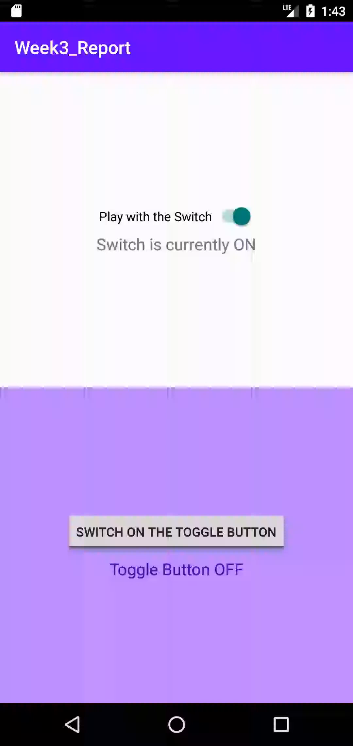
Report 3
실행화면

Slide 23
Report 4
Activity_report4.xml
<?xml version="1.0" encoding="utf-8"?> <LinearLayout xmlns:android="http://schemas.android.com/apk/res/android" xmlns:app="http://schemas.android.com/apk/res-auto" xmlns:tools="http://schemas.android.com/tools" android:id="@+id/main" android:layout_width="match_parent" android:layout_height="match_parent" tools:context=".Report4"> <LinearLayout android:layout_width="match_parent" android:layout_height="wrap_content" android:layout_margin="5dp" android:orientation="vertical"> <RadioGroup android:layout_width="match_parent" android:layout_height="wrap_content" android:layout_margin="20dp" android:orientation="horizontal"> <RadioButton android:id="@+id/shortshow" android:layout_width="0dp" android:layout_height="wrap_content"

Slide 24
android:layout_weight="1" android:checked="true" android:text="짧게 표시" /> <RadioButton android:id="@+id/longshow" android:layout_width="0dp" android:layout_height="wrap_content" android:layout_weight="1" android:checked="false" android:text="길게 표시" /> </RadioGroup> <EditText android:id="@+id/editText" android:layout_width="match_parent" android:layout_height="wrap_content" android:hint="Message 입력" /> <LinearLayout android:layout_width="match_parent" android:layout_height="wrap_content" android:layout_margin="15dp" android:orientation="vertical"> <Button android:id="@+id/toastButton" android:layout_width="match_parent"

Slide 25
android:layout_height="wrap_content" android:backgroundTint="@color/pupple_500" android:text="TOAST MESSAGE 만들기" android:textColor="@color/white" /> <Button android:id="@+id/snackbarButton" android:layout_width="match_parent" android:layout_height="wrap_content" android:backgroundTint="@color/pupple_500" android:text="SNACKBAR MESSAGE" android:textColor="@color/white" /> <Button android:id="@+id/confirmButton" android:layout_width="match_parent" android:layout_height="wrap_content" android:backgroundTint="@color/pupple_500" android:text="SNACKBAR CONFIRM MESSAGE" android:textColor="@color/white" /> </LinearLayout> </LinearLayout> </LinearLayout>
Report4.java
package com.example.myapplication; import android.os.Bundle;

Slide 26
import android.view.View; import android.widget.Button; import android.widget.EditText; import android.widget.RadioButton; import android.widget.Toast; import androidx.activity.EdgeToEdge; import androidx.appcompat.app.AppCompatActivity; import androidx.core.graphics.Insets; import androidx.core.view.ViewCompat; import androidx.core.view.WindowInsetsCompat; import com.google.android.material.snackbar.Snackbar; public class Report4 extends AppCompatActivity { @Override protected void onCreate(Bundle savedInstanceState) { super.onCreate(savedInstanceState); setContentView(R.layout.activity_report4); RadioButton shortshow = findViewById(R.id.shortshow); RadioButton longshow = findViewById(R.id.longshow); EditText editText = findViewById(R.id.editText); Button toastbutton = findViewById(R.id.toastButton); Button snackbarbutton = findViewById(R.id.snackbarButton); Button confirmbutton = findViewById(R.id.confirmButton);

Slide 27
View.OnClickListener onClickListener = new View.OnClickListener() { @Override public void onClick(View view) { String text = editText.getText().toString(); if (text.equals("")) { Toast.makeText(getBaseContext(), "입력해주세요", Toast.LENGTH_SHORT).show(); } else { int T_check; int S_check; if (shortshow.isChecked()) { T_check = Toast.LENGTH_SHORT; S_check = Snackbar.LENGTH_SHORT; } else { T_check = Toast.LENGTH_LONG; S_check = Snackbar.LENGTH_LONG; } int button_check = view.getId(); if (button_check == R.id.toastButton) { Toast.makeText(getBaseContext(), String.format("%s", text), T_check).show(); } else if (button_check == R.id.snackbarButton) { Snackbar.make(view, String.format("%s", text), S_check).show(); } else { Snackbar.make(view, String.format("확인하시겠습니까?", text), Snackbar.LENGTH_INDEFINITE).setAction("확인", new View.OnClickListener() { @Override public void onClick(View view) { Snackbar.make(view, String.format("%s", text), S_check).show(); }

Slide 28
}).show(); } } } }; toastbutton.setOnClickListener(onClickListener); snackbarbutton.setOnClickListener(onClickListener); confirmbutton.setOnClickListener(onClickListener); } }

Slide 29
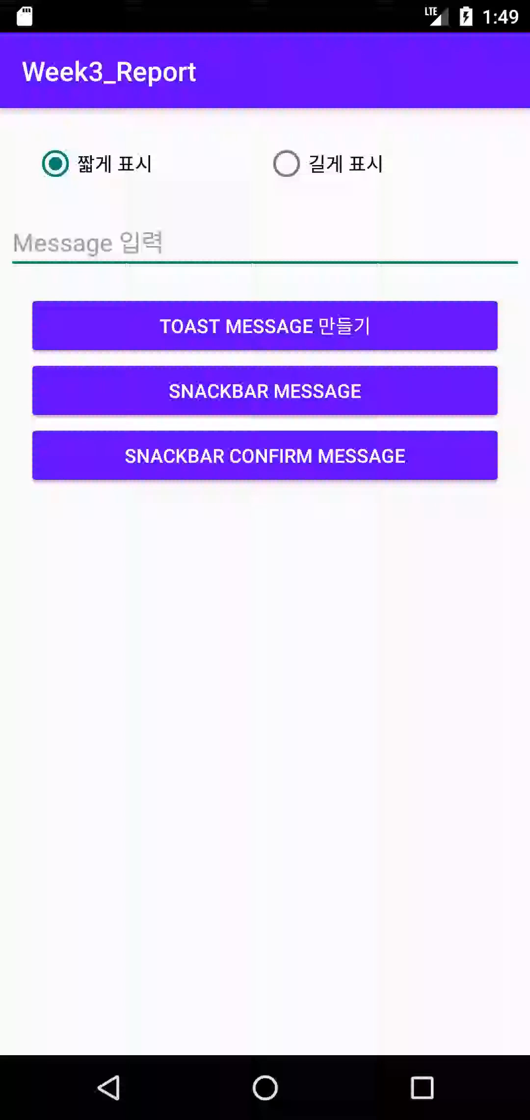
Report 4
실행화면

Slide 30
교수님 아래와 같은 질문 사항이 있습니다.
Report1번에서 ‘119 응급전화 걸기’ 버튼을 실행 할 때, 권한 부여가
필요한 것을 알게 되어 GPT의 도움을 받아 과제를 하였지만, 이에
관해 수업에서 한 번 더 알려주었으면 합니다.
2. Report4번에서 ‘Snackbar Confirm Message’ 버튼을 만들 때, 이에
관해서 수업이나, 수업자료에 언급이 없어, 이 또한 1번과 같이 수업
에서 알려주셨으면 합니다.

